Slide 1
Salesforce.com SFDC APP Demo

Slide 2
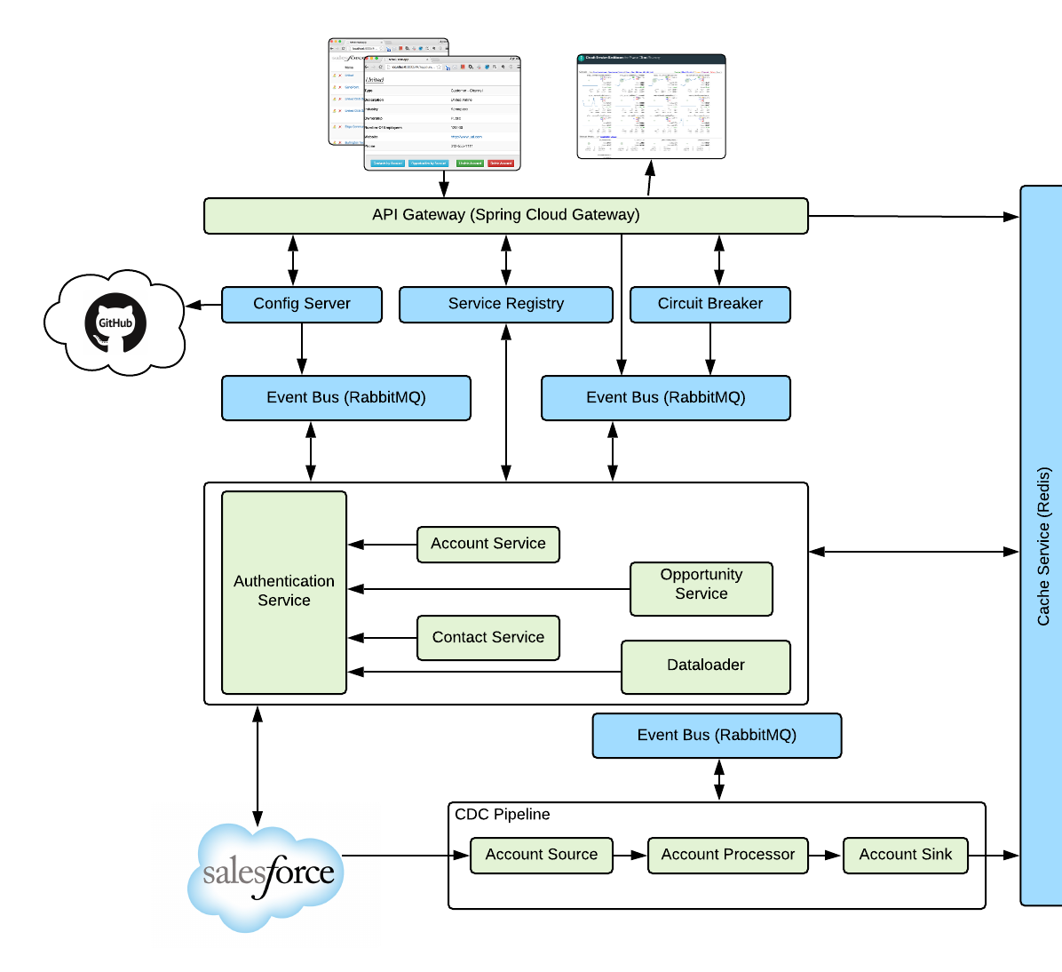
Demo Time
SFDC App built with Spring Boot and Spring Cloud Services components.
Microservices:
SalesForce web interface
API gateway service
Account data service
Contact data service
Opportunity data service
Authentication service
Data Pipeline Services
Backing Services:
Circuit Breaker Dashboard
Service Registry
Configuration management
Redis NoSQL database
RabbitMQ Messaging
Notes:
Now let’s show you Tanzu Application Service in action with a demonstration app.

Slide 3




Spring Boot + Spring Cloud Services Suite
Config Server
How to build reliable Cloud Native systems from unreliable components?
Service Registry
Spring Cloud
Services
Circuit Breaker
Notes:
Degrading Functionality
An essential part of building a resilient system, especially when your functionality is spread over a number of different microservices that may be up or down, is the ability to safely degrade functionality.

Slide 4
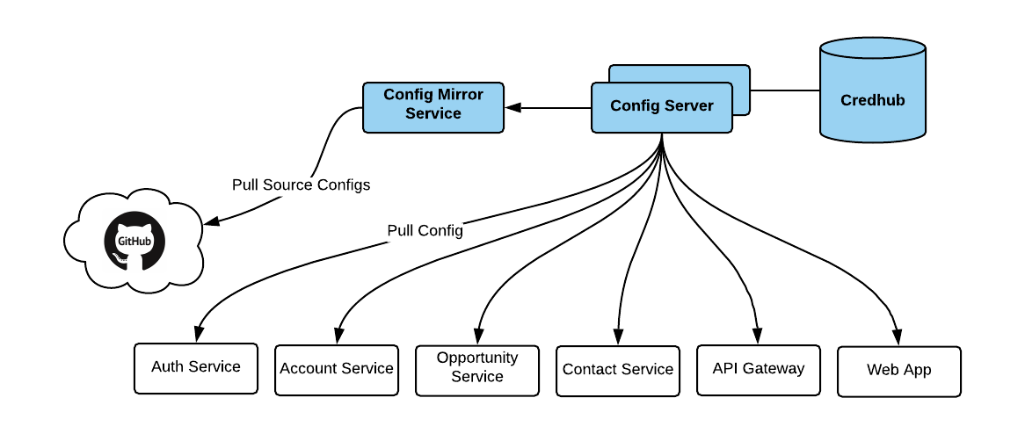
Config Server
Centralized Configurations
Integrates with SCM to provide non-repudiation audit and version control of configuration for easy roll-back
Supports for Data at Rest encryption
Support for on-demand/push notification configuration refresh without application restart

Slide 5
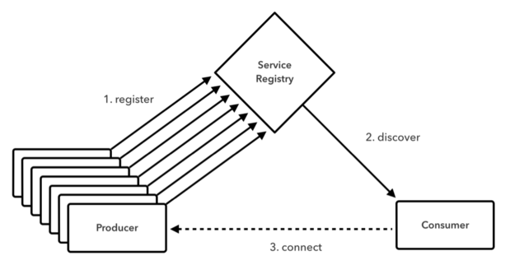
Service Registry
How does each micro-services discovers each other?
What information is provided during discovery?

Slide 6
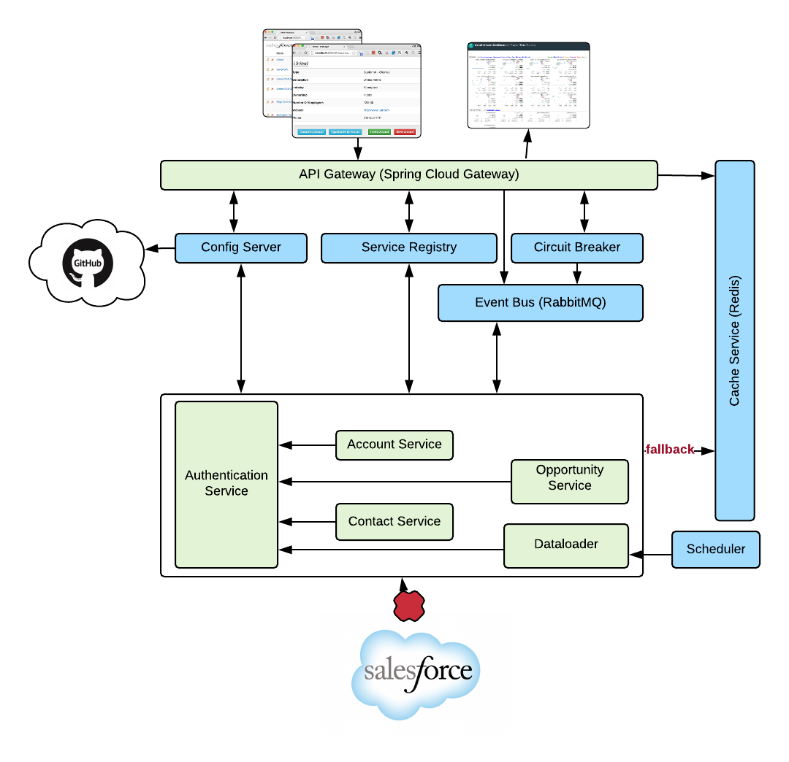
Circuit Breaker
What happens if external router is down??
Or what happens to your app when Salesforce.com has schedule maintenance??

Slide 7
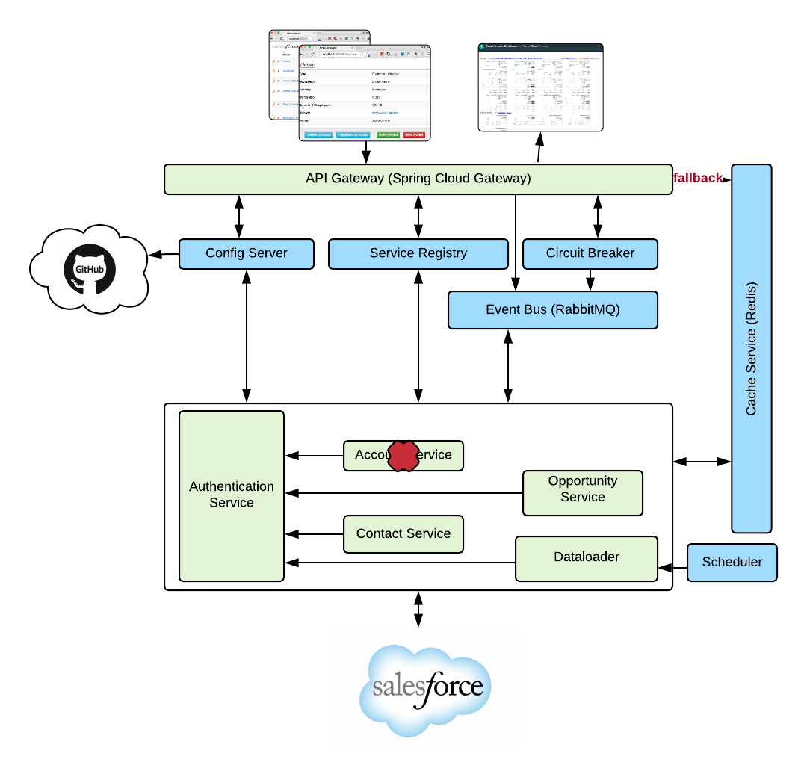
Circuit Breaker
What happens if external router is down??
Or what happens to your app when Salesforce.com has schedule maintenance??
Or one of the service is miss-behaving or down??

Slide 8
Data Pipeline
How will you rehydrate/sync cache, when system of record is updated by other means?

Slide 9
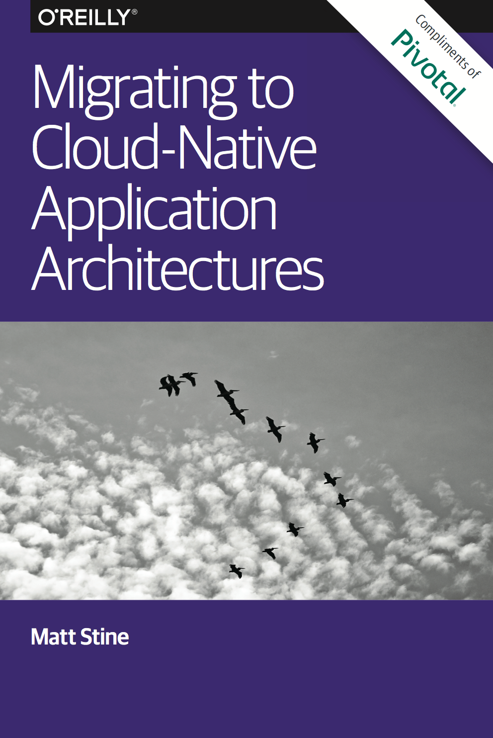
Looking to incubate a cloud native application model?
Application Framework
+
Platform Runtime
+
Infrastructure Automation
Complementary O’Reilly Book
http://bit.ly/cloud-native-book
Notes:
Looking to invest in cloud native applications? We wrote the book on it

